Slide 1
Hourglass Networks
Chen Zhao
2017.8.17

Slide 2
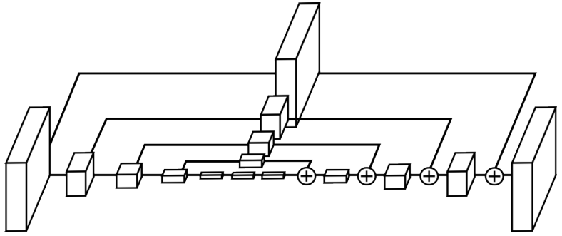
What is hourglass network
In the shape of an hourglass
Looks like
Convolutional – deconvolutional
Encoder – decoder

Slide 3
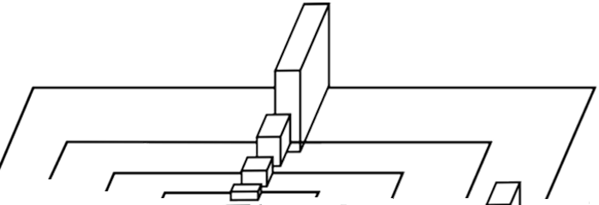
What is hourglass network
A deep neural network architecture
Featured in
Fully convolution: no fully connected layers
Symmetric architecture: convolution + upsampling
Skip layers: preserve spatial information at each scale
Skip layers
Convolutional layers
Upsampling layers
Notes:
Input can be of any dimensions

Slide 4

Compared to previous CNN
CNN for classification
Image → Categories
Convolutional layers; fully connected layers

Slide 5
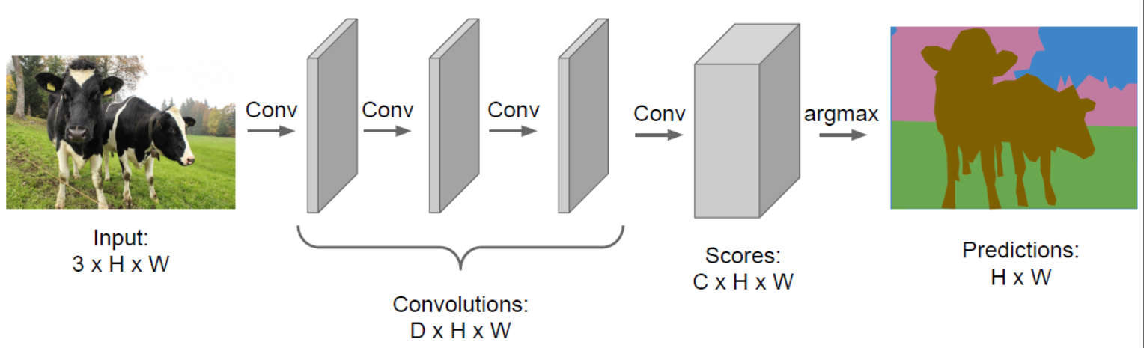
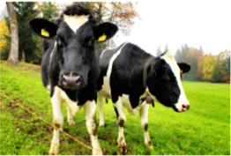
Compared to previous CNN
Hourglass network
Image → Image (segmentations, heatmaps, enhanced images)
Solely convolution layers
First half: CNN without fully connected layers
CNN without fully connected layers

Slide 6
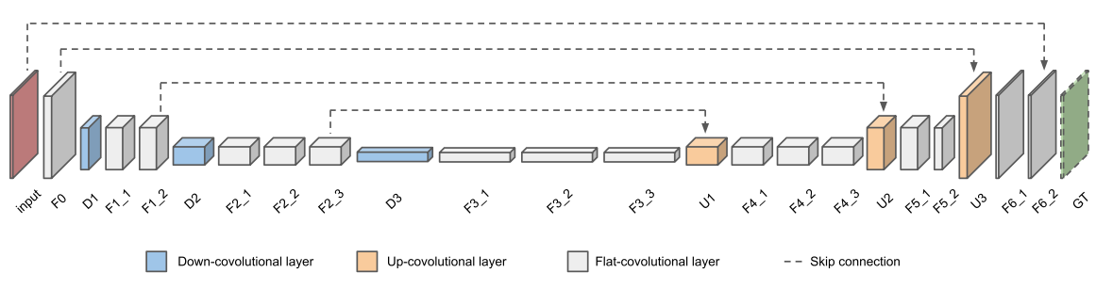
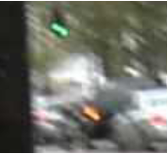
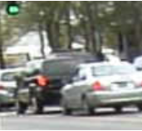
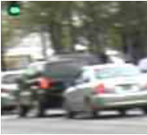
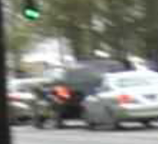
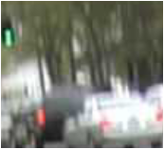
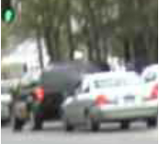
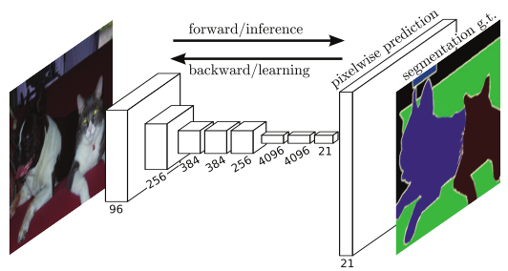
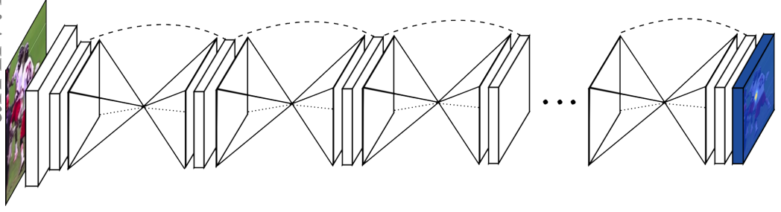
How is hourglass network applied
To spatially dense prediction tasks
Semantic segmentation¹
Pose estimation²
Deblurring³
……
1. Long, Jonathan, Evan Shelhamer, and Trevor Darrell. "Fully convolutional networks for semantic segmentation.” CVPR 2015.
2. Newell, Alejandro, Kaiyu Yang, and Jia Deng. “Stacked hourglass networks for human pose estimation.” ECCV 2016.
3. Su, Shuochen, et al. "Deep video deblurring." arXiv preprint arXiv:1611.08387 (2016).

Slide 7
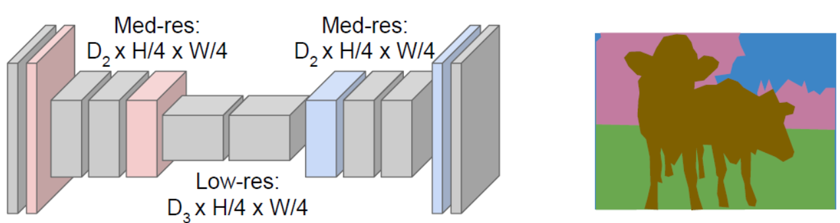
Fully Convolutional Networks for Semantic Segmentation¹
1. Long, Jonathan, Evan Shelhamer, and Trevor Darrell. "Fully convolutional networks for semantic segmentation." CVPR 2015.
Notes:
What is semantic segmentation
Importance of this paper

Slide 8
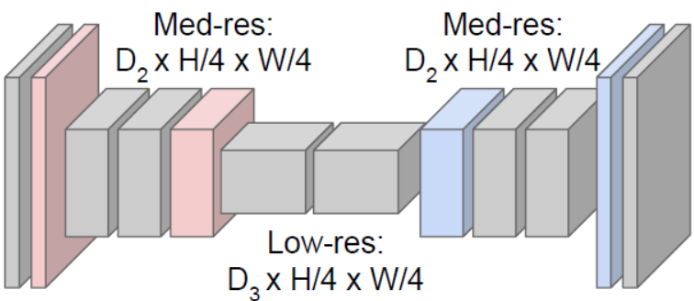

Network architecture
Fully convolution: no fully connected layers
Symmetric architecture: convolution + upsampling
Skip layers: preserve spatial information at each scale

Slide 9
Network architecture
Fully convolution: no fully connected layers
Symmetric architecture: convolution + upsampling
Skip layers: preserve spatial information at each scale

Slide 10
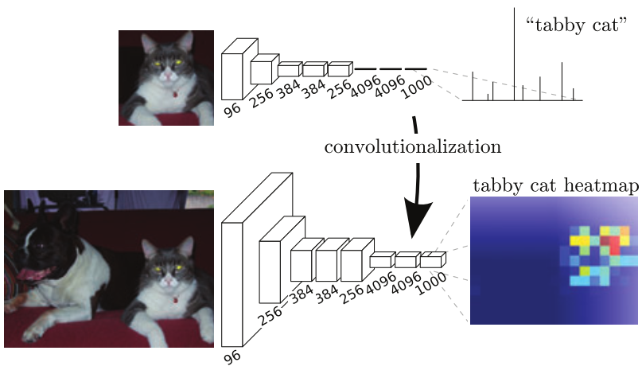
Fully convolution
Transforming fully connected layers to convolutional layers
Input can be of arbitrary size

Slide 11
Network architecture
Fully convolution: no fully connected layers
Symmetric architecture: convolution + upsampling
Skip layers: preserve spatial information at each scale

Slide 12
Convolution + upsampling
How to keep spatial size
The `a trous algorithm
No pooling
Enlarge filters

Slide 13
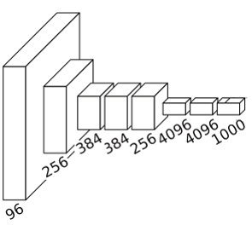
Convolution + upsampling
How to keep spatial size
The `a trous algorithm
No pooling
Enlarge filters
Shift and stitch
Shift
Stitch

Slide 14
Convolution + upsampling
How to keep spatial size
The `a trous algorithm
No pooling
Enlarge filters
Shift and stitch
In-network upsampling
Upsampling

Slide 15
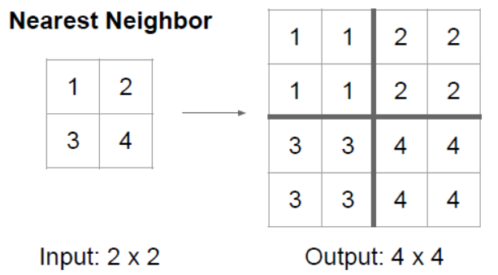
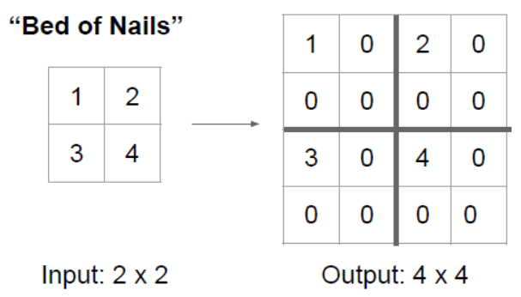
How to perform upsampling
Explicit interpolation
Nearest neighbor, bilinear, “bed of nails”, max unpooling

Slide 16
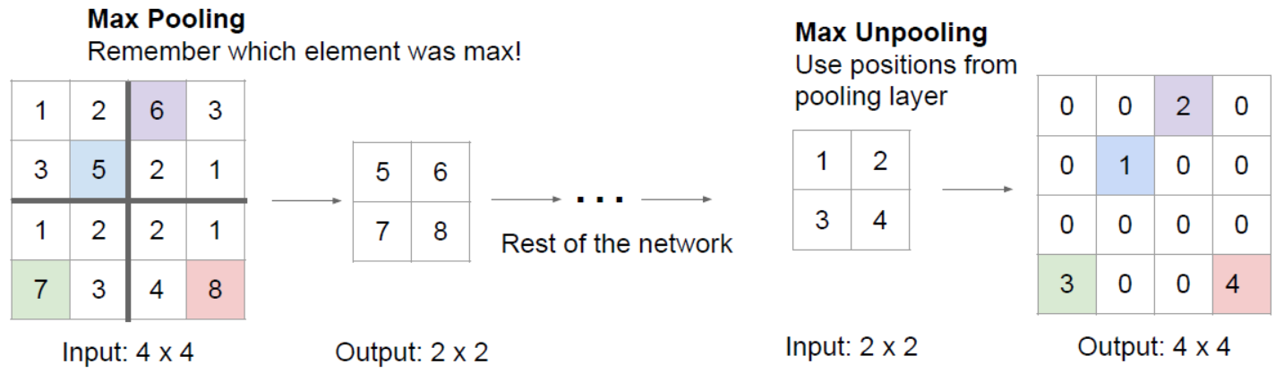
How to perform upsampling
Explicit interpolation
Nearest neighbor, bilinear, “bed of nails”, max unpooling

Slide 17
How to perform upsampling
Explicit interpolation
Nearest neighbor, bilinear, “bed of nails”, max unpooling
Learn by the network: deconvolution
Aliases: learnable upsampling, backwards strided convolution, fractional strided convolution, transpose convolution, upconvolution

Slide 18
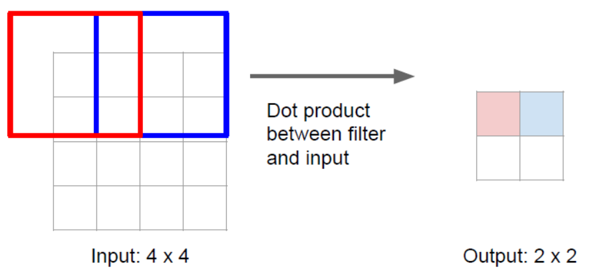
How to perform upsampling
Explicit interpolation
Nearest neighbor, bilinear, “bed of nails”, max unpooling
Learn by the network: deconvolution

Slide 19
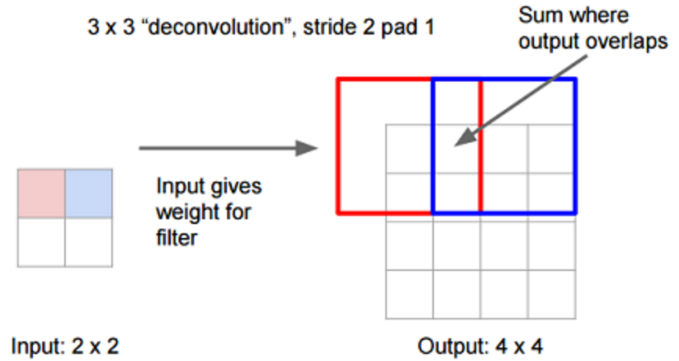
How to perform upsampling
Explicit interpolation
Nearest neighbor, bilinear, “bed of nails”, max unpooling
Learn by the network: deconvolution

Slide 20
Network architecture
Fully convolution: no fully connected layers
Symmetric architecture: convolution + upsampling
Skip layers: preserve spatial information at each scale

Slide 21
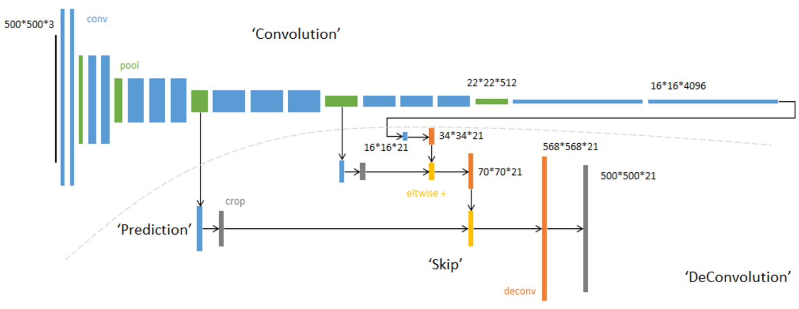
Skip layers
Combines
Semantic information from deep, coarse layers
Appearance information from shallow, fine layers
Make local predictions that respect global structure

Slide 22
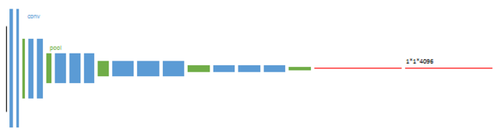
Training phases
1. Transfer learned representations from classification networks (AlexNet, VGG, GoogLeNet)
Use these parameters as initialization

Slide 23
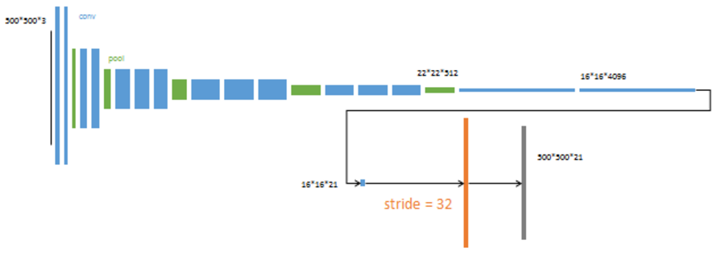
Training phases
2. FCN-32s
Predict segmentation images (16*16*21) from feature maps (16*16*4096)
Upsampled to large segmentation images (500*500*21) by stride 32

Slide 24
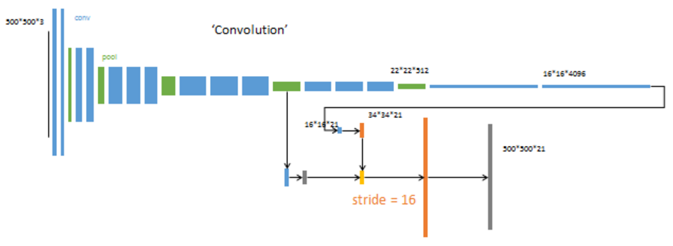
Training phases
3. FCN-16s
First, upsample 16*16*21 to 34*34*21
Second, combine predictions (blue) from pool4 (green)
Then, upsample to large segmentation images (500*500*21) by stride 16
Pool4

Slide 25
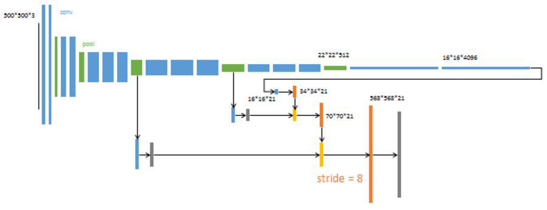
Training phases
4. FCN-8s
Perform upsampling in three steps
Combines predictions from pool3
Pool3

Slide 26
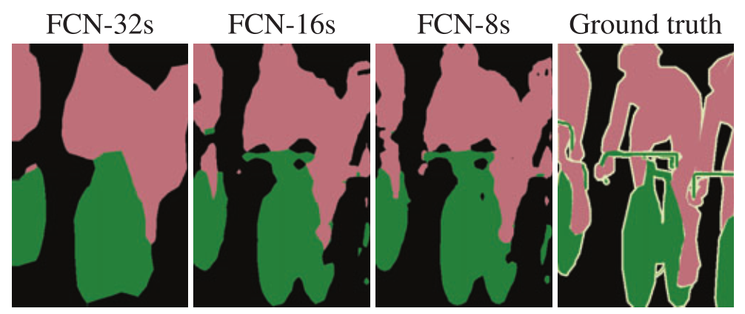
Output from different phases

Slide 27
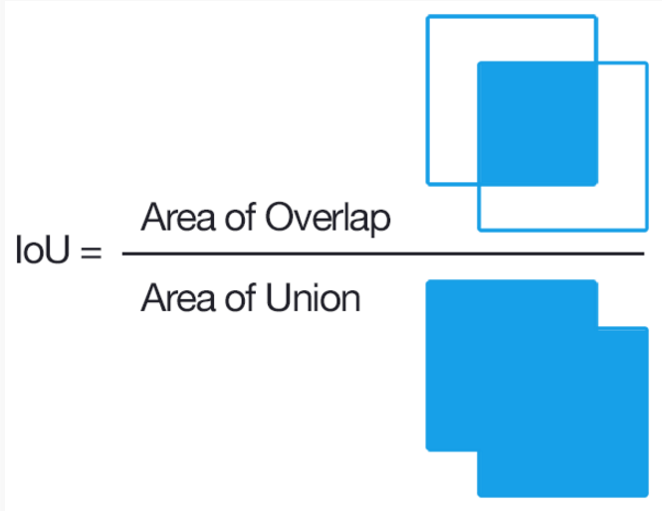
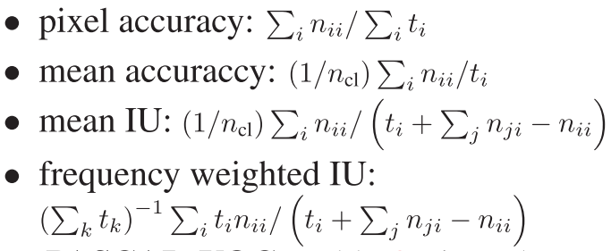
Results
Metrics: variations on pixel accuracy and region intersection over union (IoU)
Datasets: PASCAL VOC; NYUDv2; SIFT Flow

Slide 28
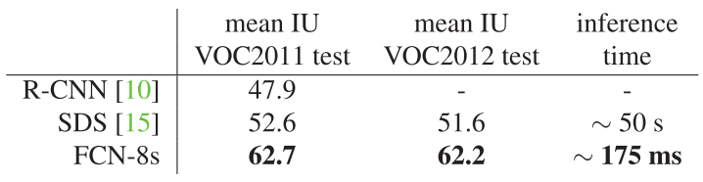
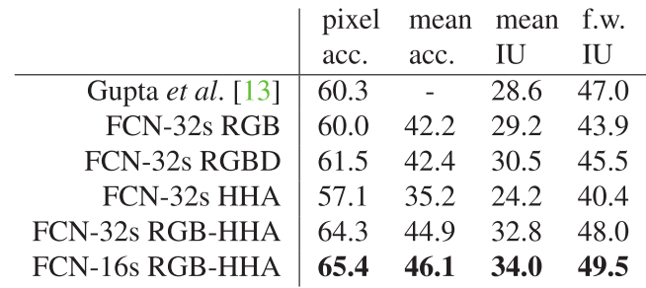
Results
PASCAL VOC
NYUDv2

Slide 29
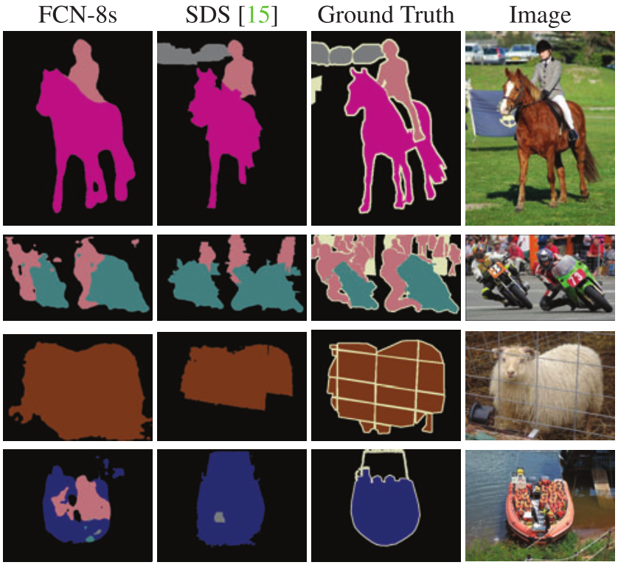
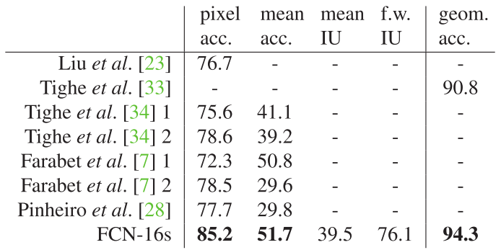
Results
SIFT Flow

Slide 30
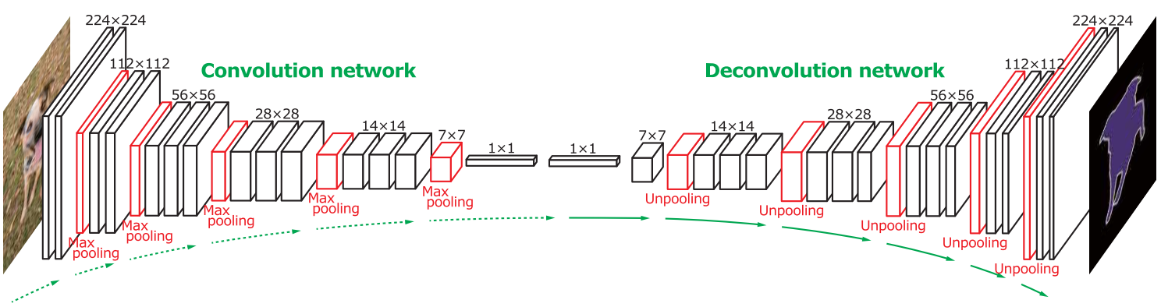
Follow-up works: DeconvNet²
Input all proposals, and integrate all outputs
Deconvolution + unpooling
2. Noh, Hyeonwoo, Seunghoon Hong, and Bohyung Han. "Learning deconvolution network for semantic segmentation." ICCV 2015.

Slide 31
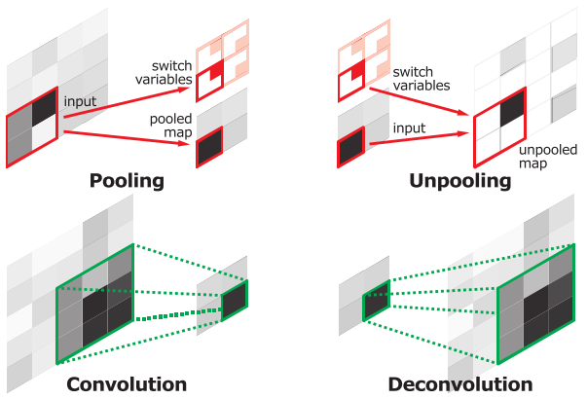
Follow-up works: DeconvNet²
Input all proposals, and integrate all outputs
Deconvolution + unpooling
2. Noh, Hyeonwoo, Seunghoon Hong, and Bohyung Han. "Learning deconvolution network for semantic segmentation." ICCV 2015.

Slide 32
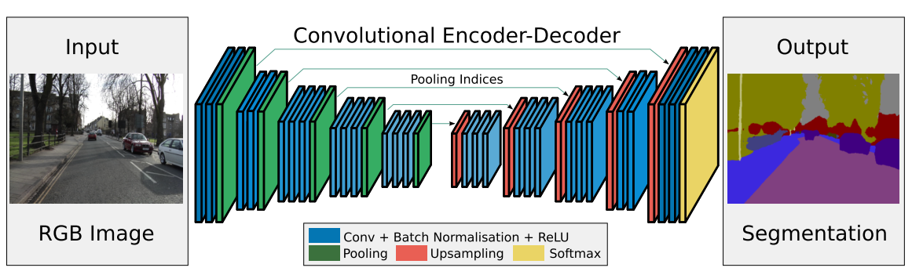
Follow-up works: Segnet³
Encoder: VGG16 without fully connected layers
Each encoder layer corresponds to a decoder layer
Max unpooling replaces deconvolution and skip
3. Badrinarayanan, Vijay, Alex Kendall, and Roberto Cipolla. "Segnet: A deep convolutional Encoder-Decoder Architecture for image segmentation." arXiv preprint arXiv:1511.00561.

Slide 33
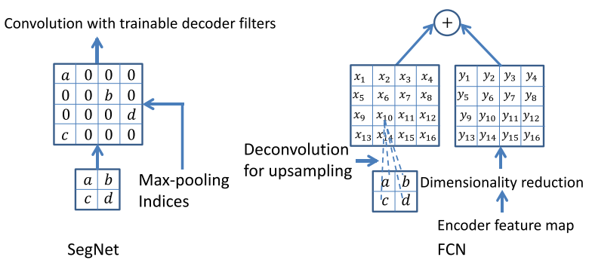
Follow-up works: Segnet³
Encoder: VGG16 without fully connected layers
Each encoder layer corresponds to a decoder layer
Max unpooling replaces deconvolution and skip
3. Badrinarayanan, Vijay, Alex Kendall, and Roberto Cipolla. "Segnet: A deep convolutional Encoder-Decoder Architecture for image segmentation." arXiv preprint arXiv:1511.00561.

Slide 34
Stacked Hourglass Networks for Human Pose Estimation¹
1. Newell, Alejandro, Kaiyu Yang, and Jia Deng. “Stacked hourglass networks for human pose estimation.” ECCV 2016.
Notes:
1. What is pose estimation
2. Why is this paper important

Slide 35
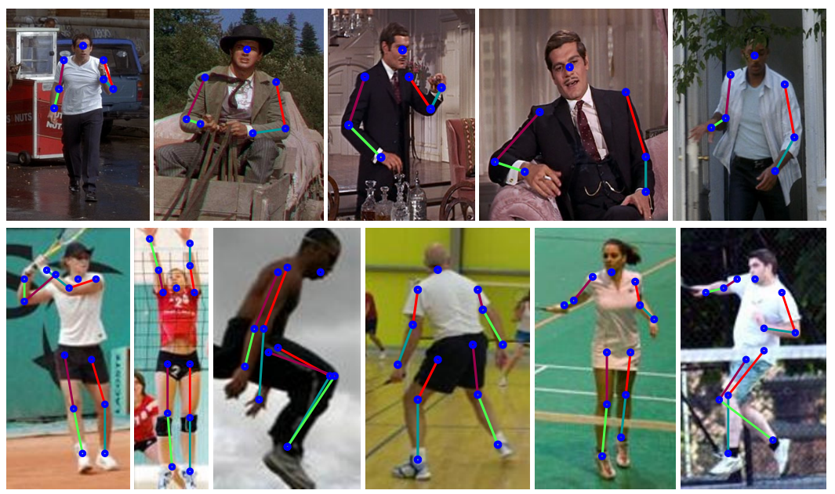
What is pose estimation
Determine the precise pixel location of important keypoints of the body

Slide 36
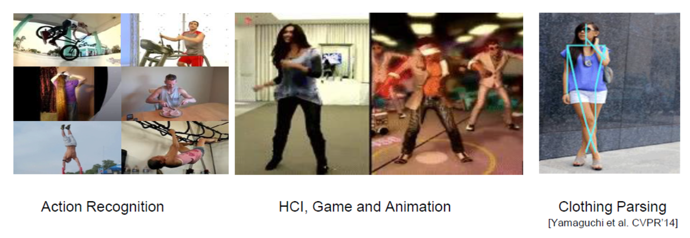
Application of pose estimation
Useful for higher level tasks: action recognition, human-computer interaction and animation

Slide 37
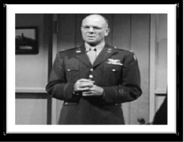
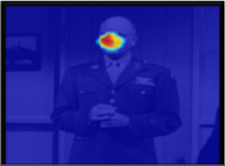
Stacked hourglass network
Hourglass: captures and consolidates information across multiple scales in one single pipeline

Slide 38
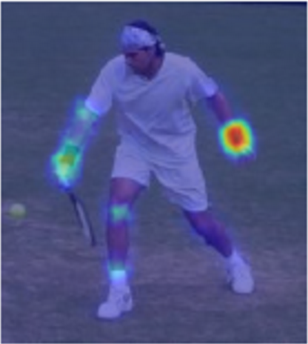
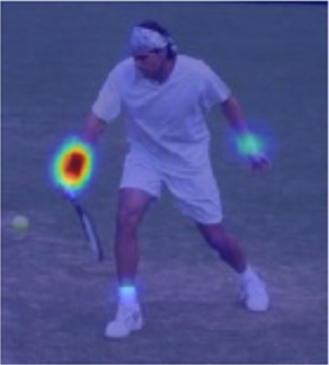
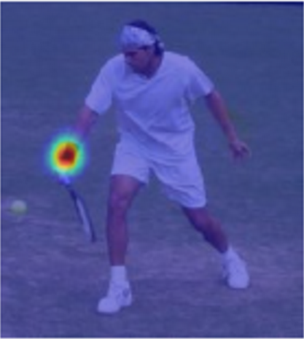
Stacked hourglass network
Hourglass: captures and consolidates information across multiple scales in one single pipeline
Stacked: allow for reevaluation of initial estimates and features in multiple stages
…
Notes:
Top-down, bottom-up, top-down, bottom-up …

Slide 39
Single hourglass
Upsampling: nearest neighbor upsampling
Capture information at every scale
Low resolution: global understanding of the full body
High resolution: local features like faces and hands

Slide 40
Single hourglass
Upsampling: nearest neighbor upsampling
Capture information at every scale
Low resolution: global understanding of the full body
High resolution: local features like faces and hands

Slide 41
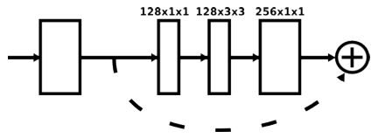
Layer implementation
Residual module: each box in the figure
Reduction step with 1*1 convolution
Performance increase

Slide 42
Intermediate supervision
Prediction of intermediate heatmaps
Loss for each hourglass
Predicted
heatmaps
…
Losses
Notes:
Loss function: MSE between predicted heatmap and groud-truth heatmap (2D gaussian with standard deviation of 1 px centered on the joint location)

Slide 43
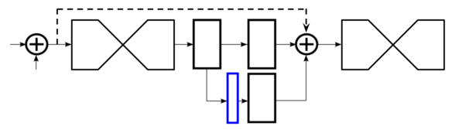

Intermediate supervision
Prediction of intermediate heatmaps
Loss for each hourglass
1*1 convolution
Predicted heatmaps

Slide 44
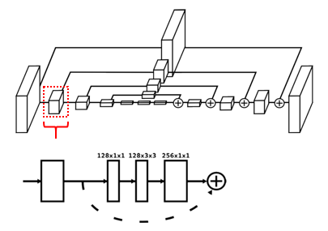
Training details
Network
All residual modules output 256 feature maps
Extra layers bring down size to 64*64, final output is also of 64*64
Two datasets
FLIC: 5003 images (3987 training, 1016 testing)
MPII Human Pose: 25k images
Preprocessing
Resize to 256*256
Data augmentation: rotation, scaling
Training
Torch7
Rmsprop
Learning rate: 2.5e-4, drop by factor 5 after plateau
3 days on a 12 GB TitanX GPU
Batch normalization

Slide 45
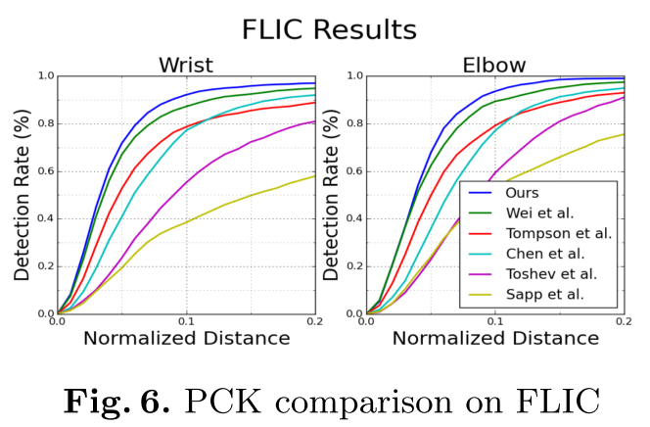
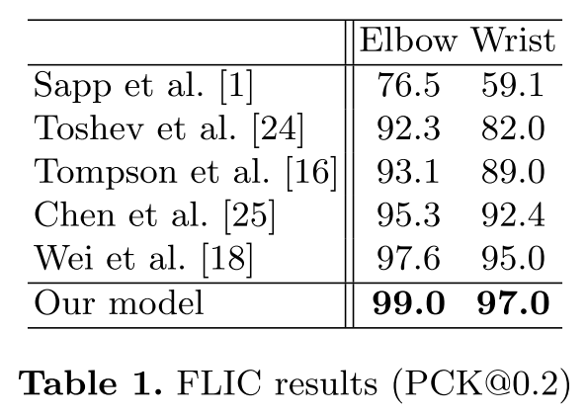
Results
Metric: percentage of correct keypoints (PCK)
The percentage of detections that fall within a normalized distance of the ground truth

Slide 46


Results

Slide 47

Ablation experiments
Effect of intermediate supervision
Effect of stacking hourglass modules together

Slide 48

Ablation experiments

Slide 49

Follow-up work: Multi-Context Attention⁴
Multi-resolution attention
4. Chu, Xiao, et al. "Multi-context attention for human pose estimation." arXiv preprint arXiv: 1702.07432 (2017).

Slide 50

Follow-up work: Multi-Context Attention⁴
Multi-semantic attention
4. Chu, Xiao, et al. "Multi-context attention for human pose estimation." arXiv preprint arXiv: 1702.07432 (2017).

Slide 51
Other applications of hourglass network
Notes:
What is semantic segmentation
Importance of this paper

Slide 52

Learning to Simplify: Fully Convolutional Networks for Rough Sketch Cleanup⁵
5. Simo-Serra, Edgar, et al. "Learning to simplify: fully convolutional networks for rough sketch cleanup." ACM Transactions on Graphics (TOG) 35.4 (2016): 121.
Notes:
What is semantic segmentation
Importance of this paper

Slide 53
Deep Video Deblurring⁶
6. Su, Shuochen, et al. "Deep video deblurring." arXiv preprint arXiv:1611.08387 (2016).
Notes:
What is semantic segmentation
Importance of this paper

Slide 54

Image compression
Notes:
What is semantic segmentation
Importance of this paper

Slide 55
Conclusions
Hourglass Networks: a neural network architecture
Applied to dense prediction problems, such as segmentation, pose estimation, enhancement
Skip layers: economic mechanism to consolidate local and global information

Slide 56
Thanks!

